Slide 1
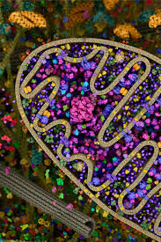
Metabolic modelling
Dr. Maria Pires Pacheco

Slide 2

Metabolism
“the chemical processes that occur within a living organism in order to maintain life.”
Food is converted into energy cellular building blocks waste

Slide 3
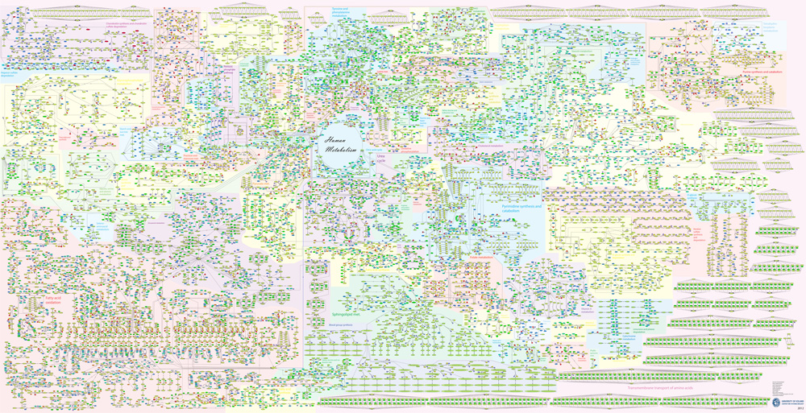
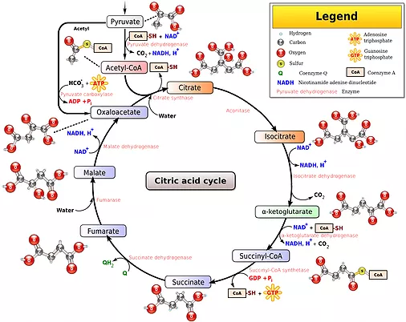
Metabolism is a network of about 1000s metabolites
Textbook view
Reality
Metabolism is split up in smaller components that are studied individually
Every pathway is affected by every other pathway

Slide 4
Pathways do not operate independently
The intracellular environment is crowded
reactions affect the microenvironment around them and therefore perturb other reactions and pathways.
Reactions only take place in a range of conditions pH, temperatures, availability of substrates, or enzymes, etc
The metabolism is submitted to a great number of constraints

Slide 5
Metabolism is a network of 1000s of metabolites
reductionist
Metabolism is split up in smaller components that are studied individually
holistic:
Rather than looking at the entities and their characteristics (mass, concentration, etc.), the holistic approach looks at the interactions

Slide 6
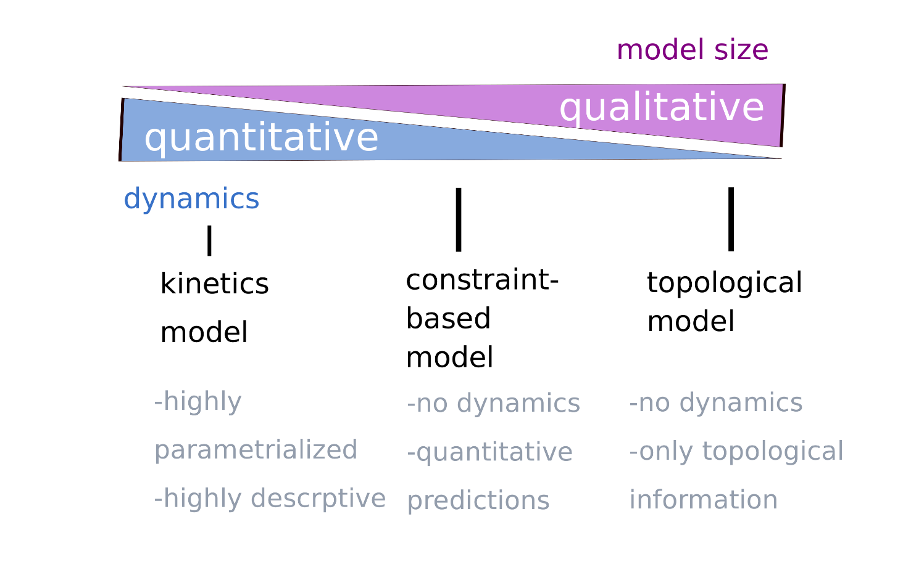
A model type for each purpose
models are a simplified representation of reality
„all models are wrong, but some are useful“ (George E. P. Box)

Slide 7
A model type for each purpose
Interaction networks
models are a simplified representation of reality
„all models are wrong, but some are useful“ (George E. P. Box)
Constraints based modelling
complexity
Genome-scale
Boolean
Networks
Kinetic modelling
mechanism

Slide 8
A model type for each purpose
Interaction networks
models are a simplified representation of reality
„all models are wrong, but some are useful“ (George E. P. Box)
Constraints based modelling
Hybrid CBM +
Kinetics
complexity
Genome-scale
FALCON
Boolean
Networks
Kinetic modelling
mechanism

Slide 9

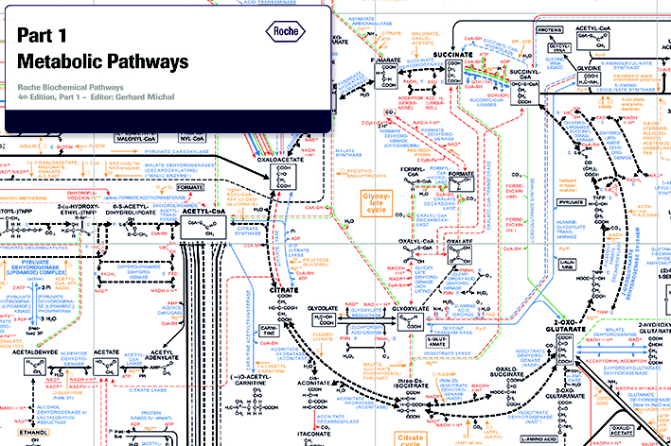
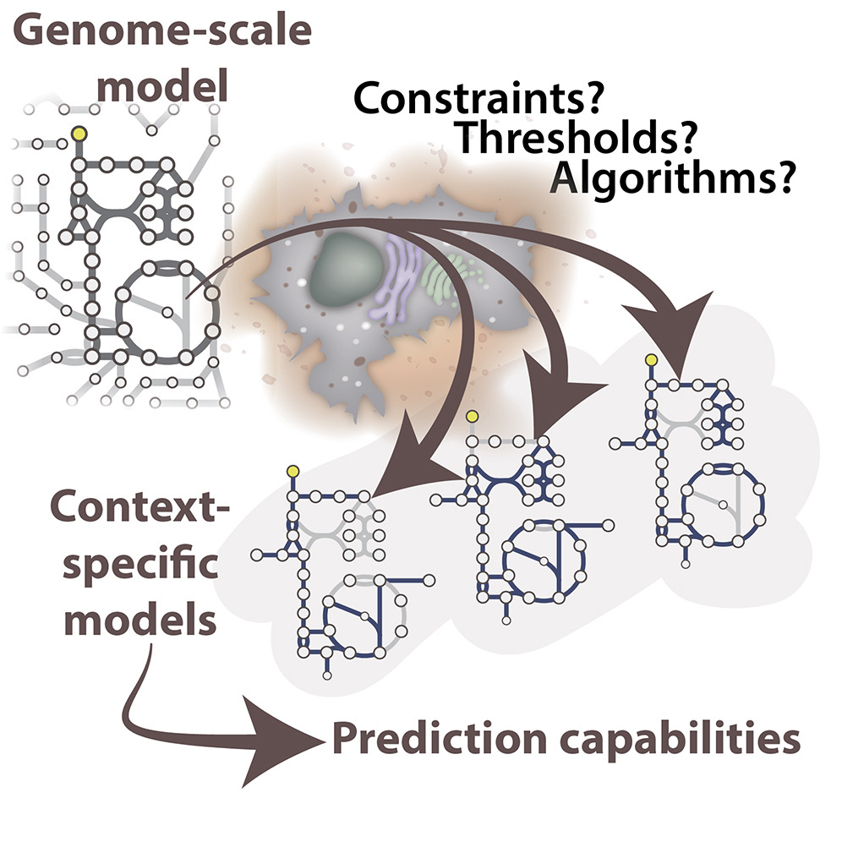
Sequencing
Constraint-based modelling: How to obtain a genome-scale reconstruction?
Databases + 70 years of biomedical literature
Knowledge-based model

Slide 10
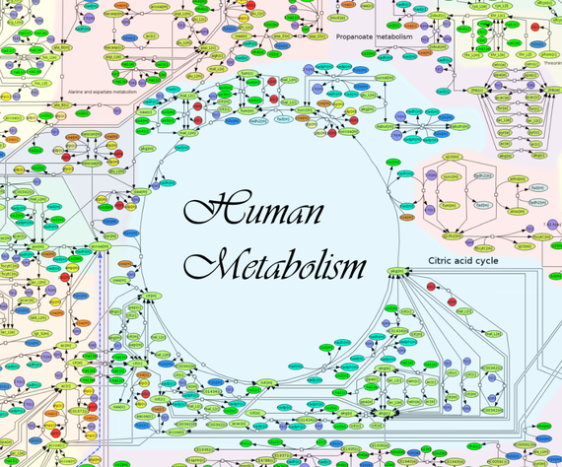
Genome-scale reconstruction
Human models:
Recon X and Human Metabolism Reconstructions:
~10000 reactions ~5000 metabolites and 1000 genes
These models are generic models. In other words, the model
represents every cell type at any time point or condition

Slide 11
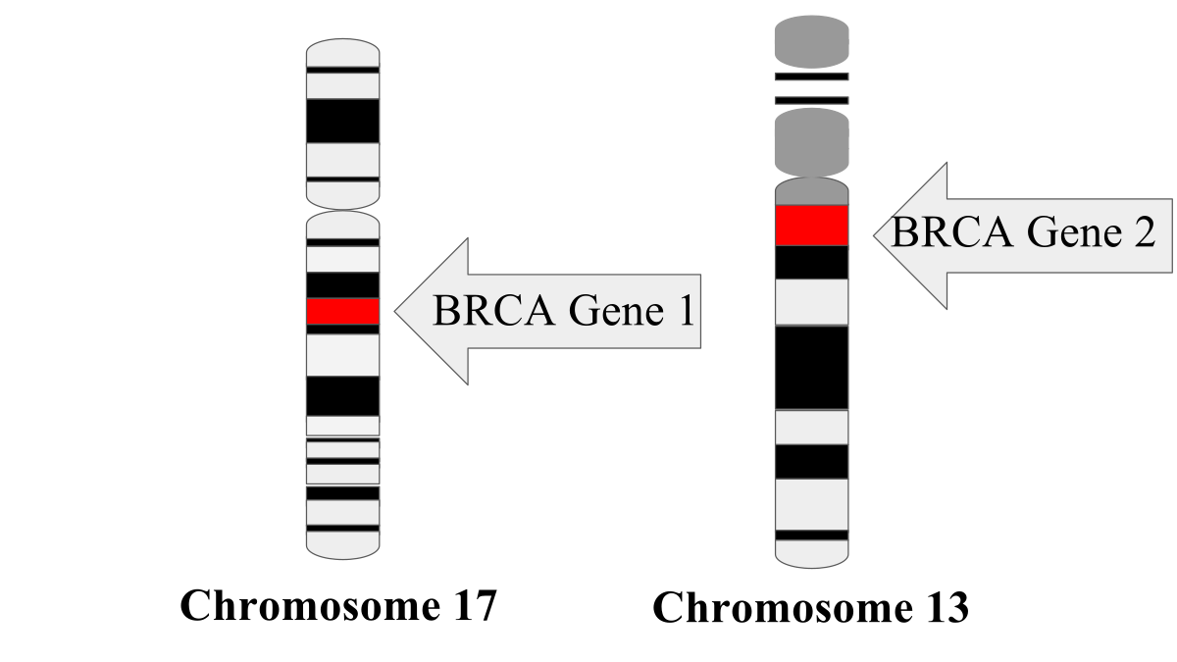
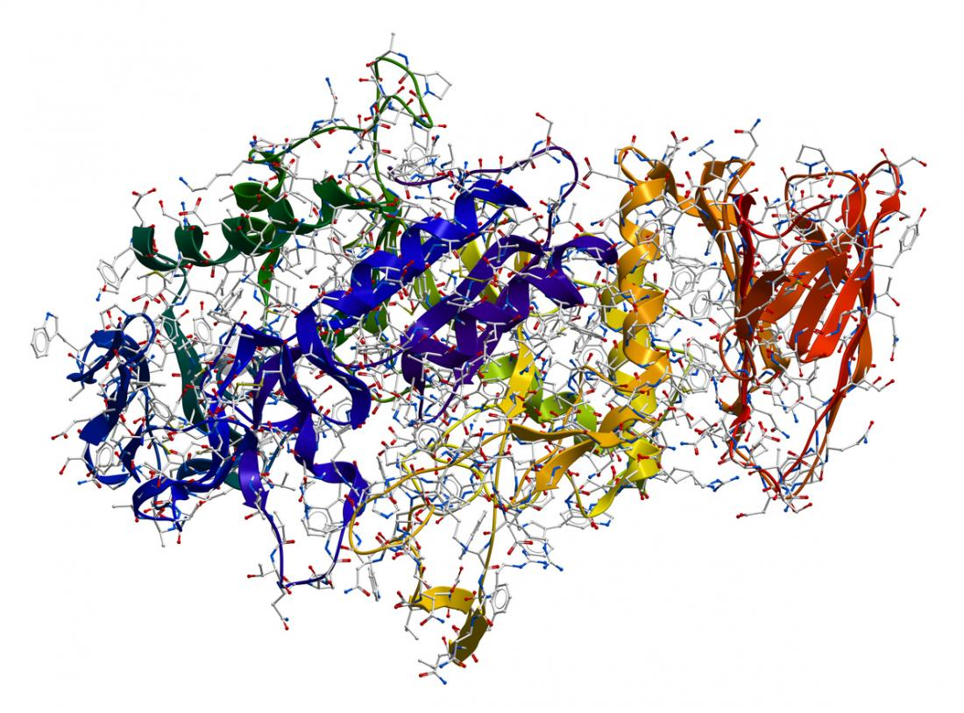
Network is an ensemble of modules
Genes are linked to proteins
Proteins are linked to reactions
Gene
Protein
Enzyme
Reaction
A B

Slide 12
Flux Balance Analysis
Ex1: → A
V1: A -> 2B
V2: 2B-> C
V3: 2B -> D
V4: D -> E
Ex2: C->
Ex3: E->
C
Ex2
v2
A
2B
Ex1
v1
Ex3
v3
D
E
v4
Lower bounds
Upper bounds
 | Ex1 | v1 | v2 | v3 | v4 | Ex2 | Ex3
A | 1 | -1 | 0 | 0 | 0 | 0 | 0
B | 0 | 2 | -2 | -2 | 0 | 0 | 0
C | 0 | 0 | 1 | 0 | 0 | -1 | 0
D | 0 | 0 | 0 | 1 | -1 | 0 | 0
E | 0 | 0 | 0 | 0 | 1 | 0 | -1
Ex1
v1
v2
v3
v4
Ex2
Ex3
0
0
-1000
0
0
0
0
1000
1000
1000
1000
1000
1000
1000
V2 is reversible
*
= 0
At the steady state

Slide 13
Matrix multiplication
Dot Product
 | Ex1 | v1 | v2 | v3 | v4 | Ex2 | Ex3
A | 1 | -1 | 0 | 0 | 0 | 0 | 0
B | 0 | 2 | -2 | -2 | 0 | 0 | 0
C | 0 | 0 | 1 | 0 | 0 | -1 | 0
D | 0 | 0 | 0 | 1 | -1 | 0 | 0
E | 0 | 0 | 0 | 0 | 1 | 0 | -1
Ex1
v1
v2
v3
v4
Ex2
Ex3
Ex1-v1
Ex1=v1
v1=v2+v3
v2= Ex2
v3=v4
v4=Ex3
2v1-2v2-v3
*
=
v2-Ex2
=0
v3-v4
v4-Ex3
5 equations , 7 variables -> undetermined
No unique solution

Slide 14
Trivial Solution
Ex1=0, v2=0
 | Ex1 | v1 | v2 | v3 | v4 | Ex2 | Ex3
A | 1 | -1 | 0 | 0 | 0 | 0 | 0
B | 0 | 2 | -2 | -2 | 0 | 0 | 0
C | 0 | 0 | 1 | 0 | 0 | -1 | 0
D | 0 | 0 | 0 | 1 | -1 | 0 | 0
E | 0 | 0 | 0 | 0 | 1 | 0 | -1
Ex1
v1
v2
v3
v4
Ex2
Ex3
Ex1-v1
Ex1=v1
v1=v2+v3
v2= Ex2
v3=v4
v4=Ex3
2v1-2v2-v3
*
=
v2-Ex2
=0
v3-v4
v4-Ex3

Slide 15
Trivial Solution
Ex1=0, v2=0
 | Ex1 | v1 | v2 | v3 | v4 | Ex2 | Ex3
A | 1 | -1 | 0 | 0 | 0 | 0 | 0
B | 0 | 2 | -2 | -2 | 0 | 0 | 0
C | 0 | 0 | 1 | 0 | 0 | -1 | 0
D | 0 | 0 | 0 | 1 | -1 | 0 | 0
E | 0 | 0 | 0 | 0 | 1 | 0 | -1
Ex1
v1
v2
v3
v4
Ex2
Ex3
Ex1-v1
0=v1
v1=0+v3
0= Ex2
v3=v4
v4=Ex3
2v1-2v2-v3
*
=
v2-Ex2
=0
v3-v4
v4-Ex3

Slide 16
Trivial Solution
Ex1=0, v2=0, v3=0
 | Ex1 | v1 | v2 | v3 | v4 | Ex2 | Ex3
A | 1 | -1 | 0 | 0 | 0 | 0 | 0
B | 0 | 2 | -2 | -2 | 0 | 0 | 0
C | 0 | 0 | 1 | 0 | 0 | -1 | 0
D | 0 | 0 | 0 | 1 | -1 | 0 | 0
E | 0 | 0 | 0 | 0 | 1 | 0 | -1
Ex1
v1
v2
v3
v4
Ex2
Ex3
Ex1-v1
0=0
0=0+v3
0= 0
v3=v4
v4=Ex3
2v1-2v2-v3
*
=
v2-Ex2
=0
v3-v4
v4-Ex3

Slide 17
Trivial Solution
C
Ex2
v2
A
2B
Ex1
v1
Ex3
v3
D
E
v4
Ex1=0, v2=0, v3=0, v4=0, Ex3=0
 | Ex1 | v1 | v2 | v3 | v4 | Ex2 | Ex3
A | 1 | -1 | 0 | 0 | 0 | 0 | 0
B | 0 | 2 | -2 | -2 | 0 | 0 | 0
C | 0 | 0 | 1 | 0 | 0 | -1 | 0
D | 0 | 0 | 0 | 1 | -1 | 0 | 0
E | 0 | 0 | 0 | 0 | 1 | 0 | -1
Ex1
v1
v2
v3
v4
Ex2
Ex3
Ex1-v1
0=0
0=0+0
0= 0
0=v4
v4=Ex3
2v1-2v2-v3
*
=
v2-Ex2
=0
v3-v4
v4-Ex3

Slide 18
Additional constraints are needed
C
Ex2
v2
A
2B
Ex1
v1
Ex3
v3
D
E
v4
 | Ex1 | v1 | v2 | v3 | v4 | Ex2 | Ex3
A | 1 | -1 | 0 | 0 | 0 | 0 | 0
B | 0 | 2 | -2 | -2 | 0 | 0 | 0
C | 0 | 0 | 1 | 0 | 0 | -1 | 0
D | 0 | 0 | 0 | 1 | -1 | 0 | 0
E | 0 | 0 | 0 | 0 | 1 | 0 | -1
Ex1=v1=1000
Ex1
v1
v2
v3
v4
Ex2
Ex3
Ex1-v1
Ex1=v1
v1=v2+v3
v2= Ex2
v3=v4
v4=Ex3
v2=Ex2=700
2v1-2v2-v3
v3=v4=Ex3=300
*
=
v2-Ex2
=0
v3-v4
v4-Ex3

Slide 19
Let‘s constrain the system
C
Ex2
v2
Add constraint
Ex3=1000
V1=1000
A
2B
Ex1
v1
Ex3
v3
D
E
v4
 | Ex1 | v1 | v2 | v3 | v4 | Ex2 | Ex3
A | 1 | -1 | 0 | 0 | 0 | 0 | 0
B | 0 | 2 | -2 | -2 | 0 | 0 | 0
C | 0 | 0 | 1 | 0 | 0 | -1 | 0
D | 0 | 0 | 0 | 1 | -1 | 0 | 0
E | 0 | 0 | 0 | 0 | 1 | 0 | -1
Ex1
v1
v2
v3
v4
Ex2
Ex3
Ex1-v1
Ex1=v1
v1=v2+v3
v2= Ex2
v3=v4
v4=Ex3
Ex1=1000
2v1-2v2-v3
1000= v2+1000
*
=
v2-Ex2
=0
v2=Ex2
v3-v4
v3=1000
v4=1000
v4-Ex3
Ex3=1000
1 unique solution

Slide 20
Space of solution for v2 and Ex2
Not allowed
Not allowed
Not allowed
No constraints
Add Constraints:
1)Bounds
2) S=V*0
v2
v2= Ex2
1000
Space of solution
0
Ex 2
Not allowed
1000
-1000
Not allowed
20

Slide 21
Space of solution for Ex1, Ex2 and Ex3
If the system is optimized for Ex2 (maximization) then we find a unique solution: Ex1 =1000, Ex2=1000, Ex3=0
No constraints
Add Constraints:
1)Bounds
Ex2
2) S=V*0
Ex1=v1
v1=v2+v3
v2= Ex2
v3=v4
V4=Ex3
Ex3
1000
x
Space of solution
x
x
0
1000
Ex1
-1000
EX1: 0
1000
1000
EX2: 0
1000
0
EX3: 0
0
1000
21

Slide 22
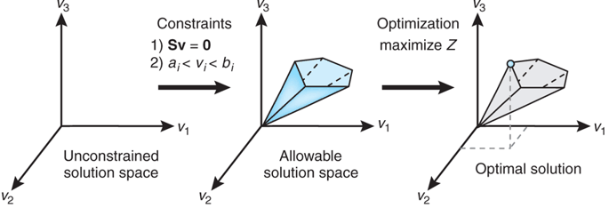
Flux Balance Analysis

Slide 23
Consistency: dead-end metabolites
Inconsistent network
Dead-end metabolite C
FASTCC is used to check the consistency of a network and to remove dead ends and gaps
v2
C
A
2B
Ex1
v1
Ex3
v3
D
E
v4
A
2B
Ex1
v1
Ex3
FASTCC
v3
D
E
v4
Consistent network

Slide 24
Consistency: gaps
Inconsistent network
FASTCC is used to check the consistency of a network and to remove dead ends and gaps
C
EX2
v2
A
2B
Ex1
v1
Ex3
v3
D
E
gap
Ex2
v2
C
A
2B
FASTCC
Ex1
v1
Consistent network

Slide 25
Constraints
Conservation of mass at the steady state
Topological constraints
pH
Medium composition
Expression of the enzymes, transporters, etc
Reversibility
Maximal flux range

Slide 26
Medium composition
Ex1
A
Model
input reactions: Ex1, Ex2, Ex4
output reactions: Ex3, Ex4, Ex5
Metabolites A, B, C, D, E, F, G, H
v1
Ex3
v2
C
Ex2
v3
v4
G
F
2B
v5
Ex5
v7
D
v6
E
Ex4
H
The medium we are constraining with only contains metabolite A.
Metabolite G and F will no longer be able to be taken up

Slide 27
Medium composition
Ex1
A
Model
input reactions: Ex1, Ex2, Ex4
output reactions: Ex3, Ex4, Ex5
Metabolites A, B, C, D, E, F, G, H
x
x
v1
Ex3
v2
C
Ex2
v3
v4
x
G
F
2B
v5
Ex5
v7
D
v6
E
Ex4
x
H
The medium we are constraining with only contains metabolite A.
Metabolite G and F will no longer be able to be taken up

Slide 28
Medium composition
Ex1
A
Model
input reactions: Ex1, Ex2, Ex4
output reactions: Ex3, Ex4, Ex5
Metabolites A, B, C, D, E, F, G, H
x
x
v1
Ex3
v2
C
v3
x
x
Ex2
v4
2B
x
G
F
v5
Ex5
v7
D
v6
E
Ex4
x
H
The medium we are constraining with only contains metabolite A.
Metabolite G and F will no longer be able to be taken up

Slide 29
Medium composition
Ex1
A
Medium constrained Model
input reactions: Ex1
output reactions: Ex3, Ex4, Ex5
Metabolites A, B, C, D, E, H
v1
Ex3
v2
C
2B
v5
Ex5
v7
D
v6
E
Ex4
H
The medium we are constraining with only contains metabolite A.
Metabolite G and F will no longer be able to be taken up

Slide 30
Constraints
Conservation of mass at the steady state
Topological constraints
pH
Medium composition
Expression of the enzymes, transporters, etc
Reversibility
Maximal flux range

Slide 31
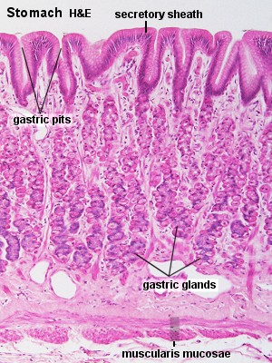
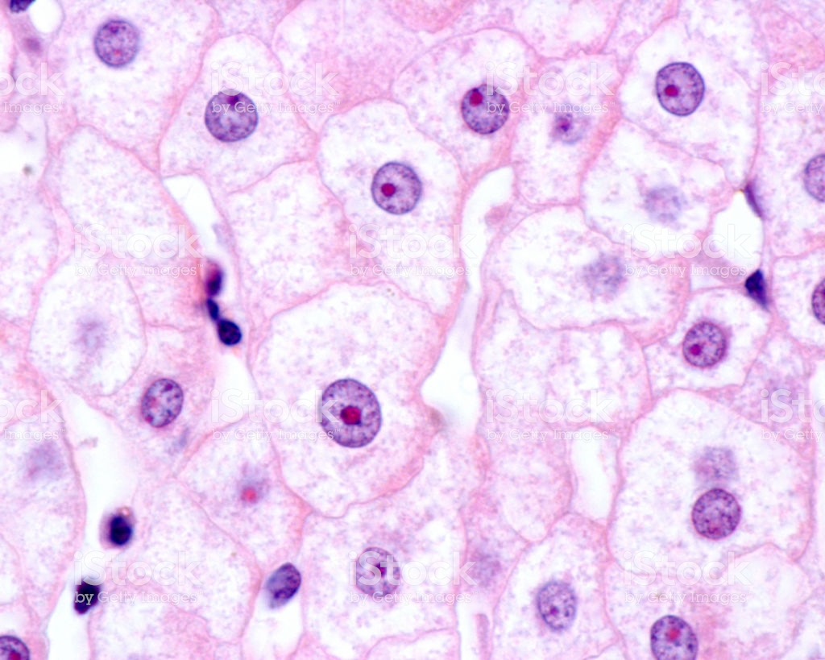
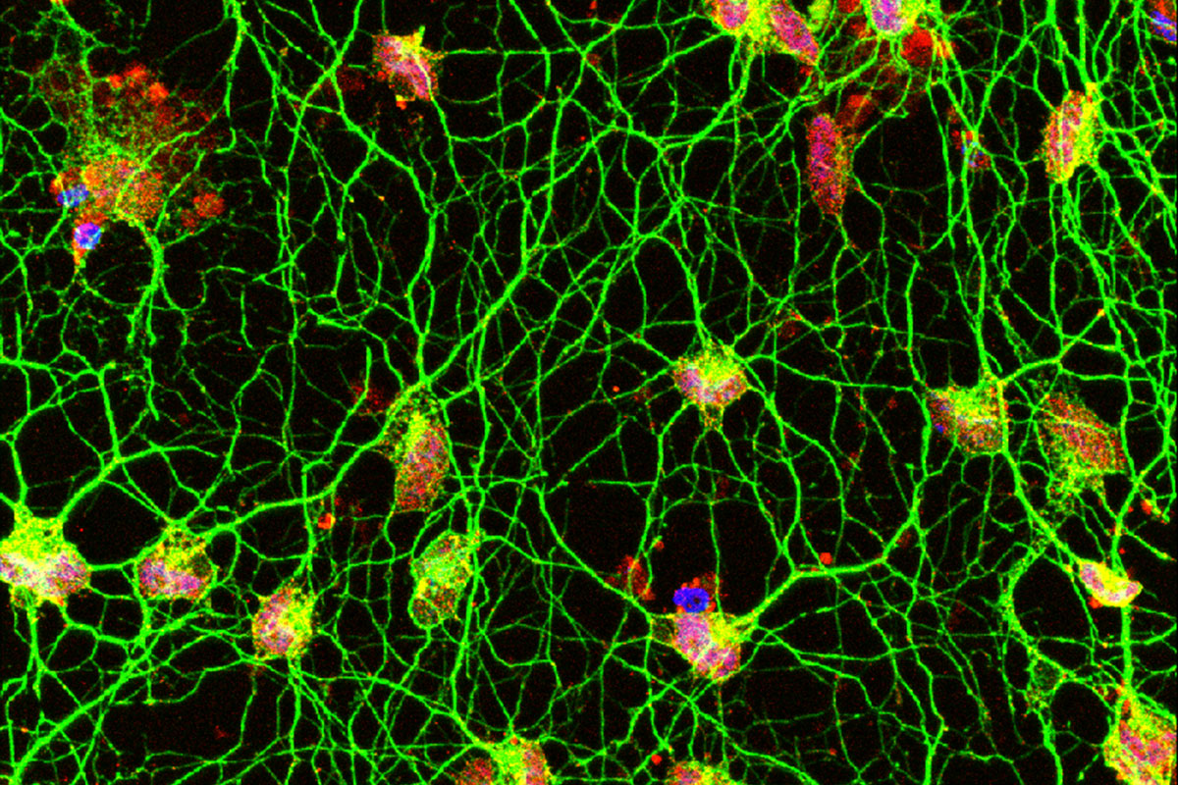
Different cell types have different morphologies, functions and metabolism
liver
intestine cells
neurons

Slide 32
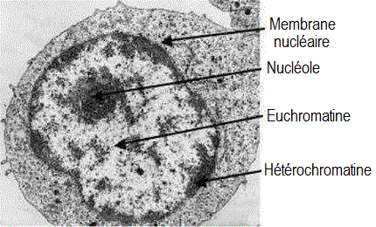
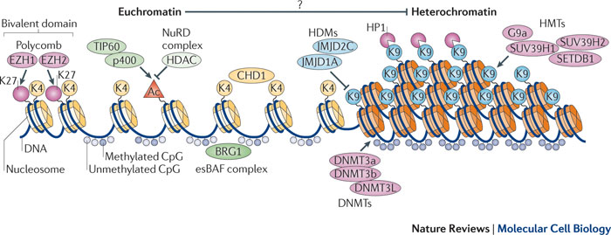
Every somatic cell of an individual shares the same genome but its expression varies

Slide 33

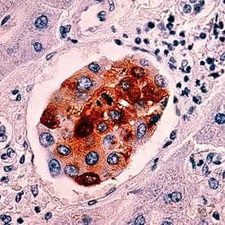
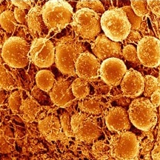
Different cell types have different morphologies, functions, and metabolism
Extraction of context specific data after integration of omics data
neurons
cancer
Global Reconstruction
Recon2: 7000 reactions, 5000 metabolites,
2000 genes

Slide 34
Context-specific models have higher prediction power
Context-specific models
contain only reactions active in the context of interest
allow to integrate transcriptomic, proteomic, epigenomic, metabolomic data
capture metabolic models between healthy and disease state.
neuron
intestine
liver

Slide 35
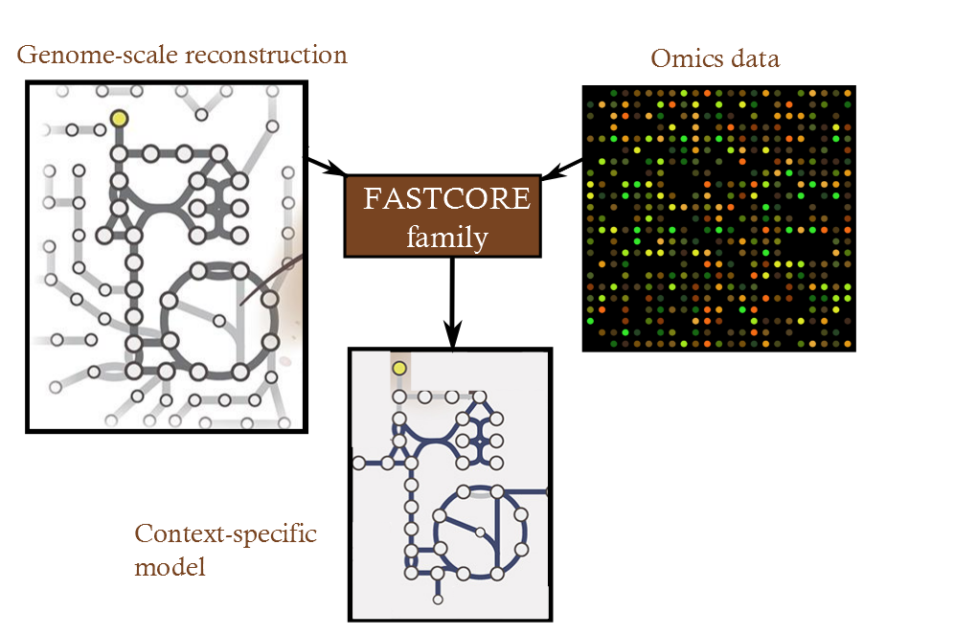
Context-specific building algorithms extract a subnetwork that contain only reactions that are active in the context of interest
Context-specific
building algorithms algorithms
Context-specific model have a higher predictability as the genome-scale reconstruction as they do not contain reactions that are inactive in the context of interest.

Slide 36
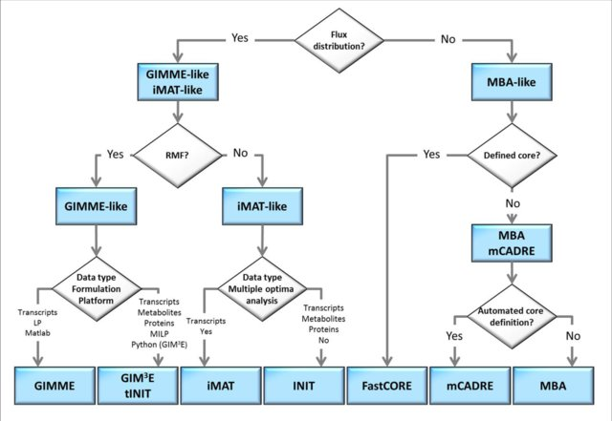
Different context-specif algorithms exist...
GIMME:
requires an optimization function
GIMME adds reactions required to guarantee a function such as growth or ATP maintenance

Slide 37
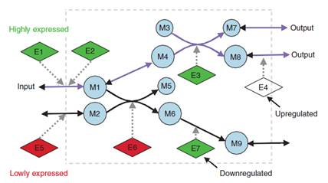
Different context-specif algorithms exist...
IMAT:
maximizes the consistency between fluxes and expression values

Slide 38
Different context-specif algorithms exist...
MBA
takes as input a set of reactions that are supported by the data or literature and finds the smallest set of reactions required to make the model consistent

Slide 39
Different context-specif algorithms exist...
FASTCORE
uses a set of core reactions that is guaranteed to be active in the extracted model and finds the minimum of reactions possible to support the core.

Slide 40
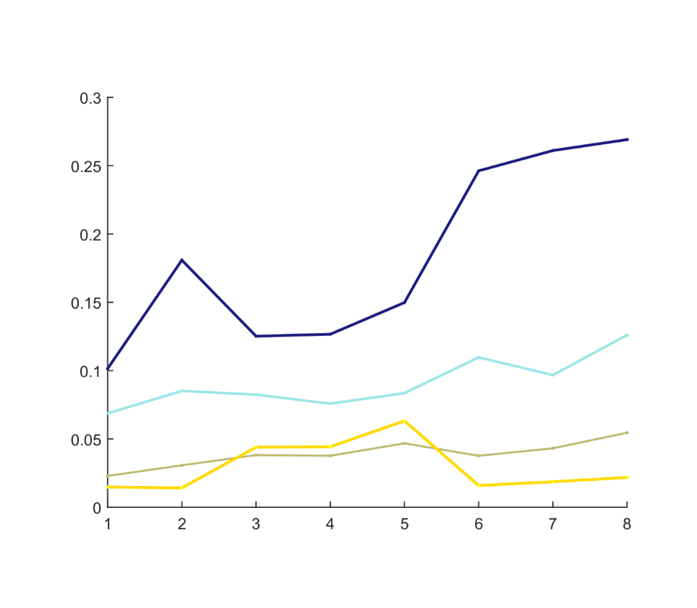
The FASTCORE* family includes more reactions with high confidence levels
High
Model | Time in seconds | Accuracy
GIMME | 4458 | low
iMAT | 2098 | medium
INIT | 36002 | low
RegrEx | 64 | low
Akesson | 54 | low
FASTCORE | 17 | high
FASTCORMICS FASTCORMICS RNASeq | 112 161 | high high
Confidence levels
Medium
Low
Undetected
GIMME
IMAT
INIT
RegrEX
Akesson
FASTCORE
Proteomic data retrieved
from the Human Protein Atlas
FASTCORMICS
Benchmarking paper : Pires Pacheco et al, 2016, Frontiers in physiology
FASTCORMICS RNAseq: Pires Pacheco et al, in preparation

Slide 41
The FASTCORE* family builds context-specific metabolic models
FASTORMICS for microarray data
(Pacheco et al, 2015)
rFASTCORMICS for RNAseq data
(Pacheco et al, 2018)
fastgapfill for gapfilling
(Ines et al, 2014)

Slide 42
How to build a model
Data preprocessing and discretization
Mapping and etablishment of the core reactions, and inactive set
Constraints (biomass and medium constraints)
Model building

Slide 43
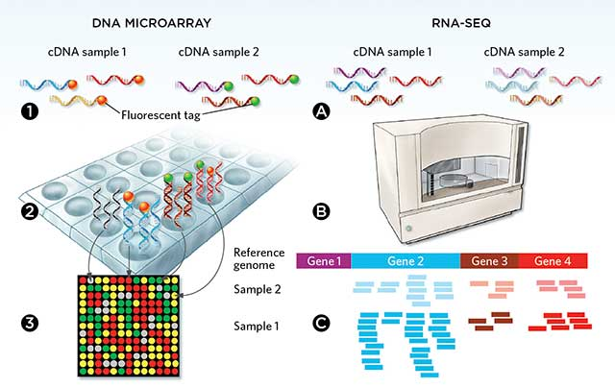
Each data type requires a specific discretization process

Slide 44
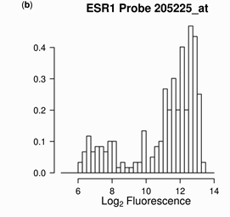
What does expressed mean? Micrroarray data
Barcode is a discretization approach that uses knowledge gathered for each probe set across 1000s of arrays and condition to identify the intensity values corresponding to noise.

Slide 45
What does expressed mean? RNA-seq data
Density histogram of gene expression
Not expressed
(-1)

Slide 46
What does expressed mean? RNA-seq data
Density histogram of gene expression
Not expressed
(-1)
Expressed
(1)

Slide 47
How to build a model
Data preprocessing and discretization
Mapping and etablishment of the core reactions, and inactive set
Constraints (biomass and medium constraints)
Model building

Slide 48
Mapping of expression data via GPR rules
OR
AND
A B
A B
Gene 1
Gene 1
OFF ( -1)
ON (1)
OFF ( -1)
ON (1)
OFF ( -1)
-1
-1
OFF ( -1)
-1
1
min( Gene 1, Gene2)
max( Gene 1, Gene2)
Gene 2
Gene 2
ON (1)
-1
1
ON (1)
1
1

Slide 49
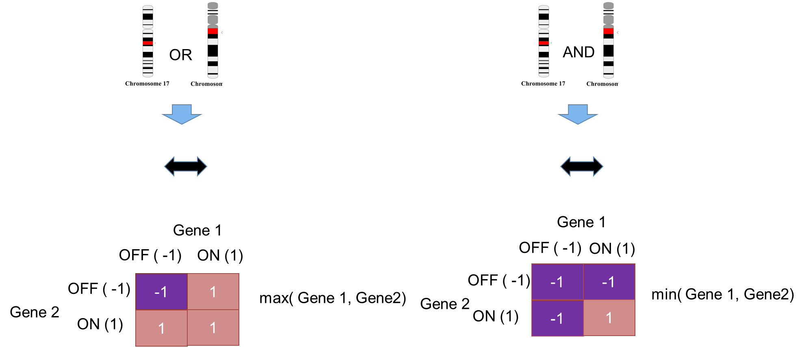
Data
Gene 1: 9.5
Gene 2: 0.1
Gene 3: 1
Gene 4: 100
discretization
Gene 1:1
Gene 2: -1
Gene 3: 0
Gene 4: 1
Reaction is ON
with a score of 1
Reaction is OFF
-1
Lower and upper bounds are set to 0
Core reactions

Slide 50
Mapping of expression data via GPR rules
OR
AND
A B
A B
Gene 1
Gene 1
unknown(0)
ON (1)
unknown ( 0)
ON (1)
unknown ( 0)
0
0
unknown 0
0
1
min( Gene 1, Gene2)
max( Gene 1, Gene2)
Gene 2
Gene 2
ON (1)
0
1
ON (1)
1
1

Slide 51
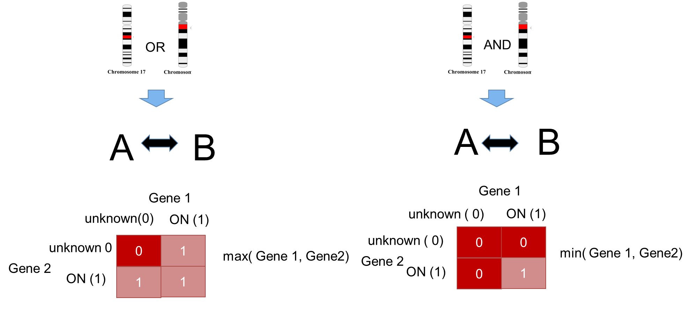
Data
Gene 1: 9.5
Gene 2: 0.1
Gene 3: 1
Gene 4: 100
discretization
Gene 1:1
Gene 2: -1
Gene 3: 0
Gene 4: 1
Reaction is ON
with a score of 1
Reaction is unknown
0
Non core reaction
Core reactions

Slide 52
How to build a model
Data preprocessing and discretization
Mapping and etablishment of the core reactions, and inactive set
Constraints (biomass and medium constraints)
Model building

Slide 53
Medium composition with maximization of Ex5
Ex1
A
Model
input reactions: Ex1
output reactions: Ex3, Ex4, Ex5
Metabolites A, B, C, D, E, H
Constraint: maximize Ex5
v1
Ex3
v2
C
Ex2
v3
v4
x
G
F
2B
v5
Ex5
v7
D
v6
E
Ex4
x
H
The medium we are constraining with only contains metabolite A.
Metabolite G and F will no longer be able to be taken up

Slide 54
Medium composition with maximization of Ex5
Ex1
A
Model
input reactions: Ex1
output reactions: Ex3, Ex4, Ex5
Metabolites A, B, C, D, E, H
Constraint: maximize Ex5
The fastest way to maximize Ex5:
Ex1 -> v1 -> v5 -> v6 -> Ex5
v1
Ex3
v2
C
Ex2
v3
v4
x
G
F
2B
v5
Ex5
v7
D
v6
E
Ex4
x
H
The medium we are constraining with only contains metabolite A.
Metabolite G and F will no longer be able to be taken up

Slide 55
How to build a model
Data preprocessing and discretization
Mapping and etablishment of the core reactions, and inactive set
Constraints (biomass and medium constraints)
Model building

Slide 56
FASTCORE family: Principle
Core reactions: reactions supported by the data are forced to carry a flux above epsilon (small positive value) by an approximation of the cardinality function
Non Core reactions: the inclusion of reactions not supported by the data is minimized by a L1-regularization (the inclusion on non-core reactions is penalized so that only non core reactions that are required to allow core reactions to be consistent are included)
FASTCORE
FASTCORMICS
rFASTOCRMICS
Ex2
v2
C
A
2B
A
2B
Ex1
v1
Ex3
Ex1
v1
Ex3
v3
D
E
v3
D
E
v4
v4
Core reaction
Core reaction
V4 is forced to carry a flux while the flux though v2 is minimized

Slide 57
Medium composition with maximization of Ex5
Ex1
A
Model
input reactions: Ex1
output reactions: Ex3, Ex4, Ex5
Metabolites A, B, C, D, E, H
Constraint: maximize Ex5
The fastest way to maximize Ex5:
Ex1 -> v1 -> v5 -> v6 -> Ex5
v1
Ex3
v2
C
Ex2
v3
v4
x
G
F
2B
v5
Ex5
v7
D
v6
E
Ex4
x
H

Slide 58
Mapping of the discretized data
Ex1
A
Model
input reactions: Ex1
output reactions: Ex3, Ex4, Ex5
Metabolites A, B, C, D, E, H
Constraint: maximize Ex5
v1
Ex3
v2
C
Ex2
v3
v4
x
G
F
2B
v5
Ex5
v7
D
v6
E
Ex4
x
H
From the discretized experimental data:
Core reactions Ex3, v7 (forced to carry a flux)
Inactive reactions v2
(do not carry a flux)

Slide 59
Removal of inactive reactions
Ex1
A
Model
input reactions: Ex1
output reactions: Ex3, Ex4, Ex5
Metabolites A, B, C, D, E, H
Constraint: maximize Ex5
v1
Ex3
v2
C
Ex2
v3
v4
x
G
F
2B
v5
Ex5
v7
D
v6
E
Ex4
x
H
From the discretized experimental data:
Core reactions Ex3, v7 (forced to carry a flux)
Inactive reactions v2
(do not carry a flux)

Slide 60
Removal of inactive reactions
Ex1
A
Model
input reactions: Ex1
output reactions: Ex3, Ex4, Ex5
Metabolites A, B, C, D, E, H
Constraint: maximize Ex5
v1
Ex3
C
2B
v5
Ex5
v7
D
v6
E
Ex4
H
From the discretized experimental data:
Core reactions Ex3, v7 (forced to carry a flux)
Inactive reactions v2
(do not carry a flux)

Slide 61
Force remaining core reactions to carry a flux
Ex1
A
Model
input reactions: Ex1
output reactions: Ex3, Ex4, Ex5
Metabolites A, B, C, D, E, H
Constraint: maximize Ex5
v1
2B
v5
Ex5
v7
D
v6
E
Ex4
H
From the discretized experimental data:
Core reactions Ex3, v7 (forced to carry a flux)
Inactive reactions v2
(do not carry a flux)

Slide 62
Output model
Ex1
A
Model
input reactions: Ex1
output reactions: Ex3, Ex4, Ex5
Metabolites A, B, C, D, E, H
Constraint: maximize Ex5
v1
2B
v5
Ex5
v7
D
v6
E
Ex4
H
From the discretized experimental data:
Core reactions Ex3, v7 (forced to carry a flux)
Inactive reactions v2
(do not carry a flux)

Slide 63
Applications

Slide 64
10005 models were built using the FASTCORMICS RNA-seq workflow
TCGA dataset contains 10005 RNA-seq samples across 24 cancer types
All 10005 models were built in less than 5 days on an ordinary computer
FASTCORMICS RNAseq: Pires Pacheco et al, in preparation

Slide 65
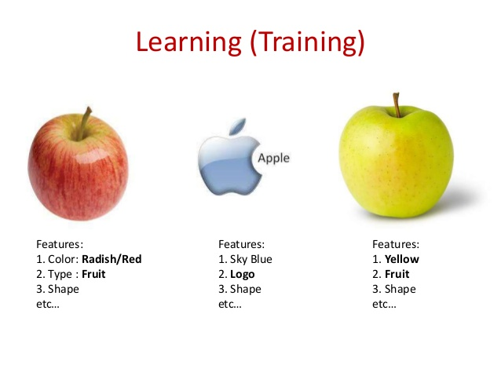

Machine learning approach: feature selection
Validation

Slide 66
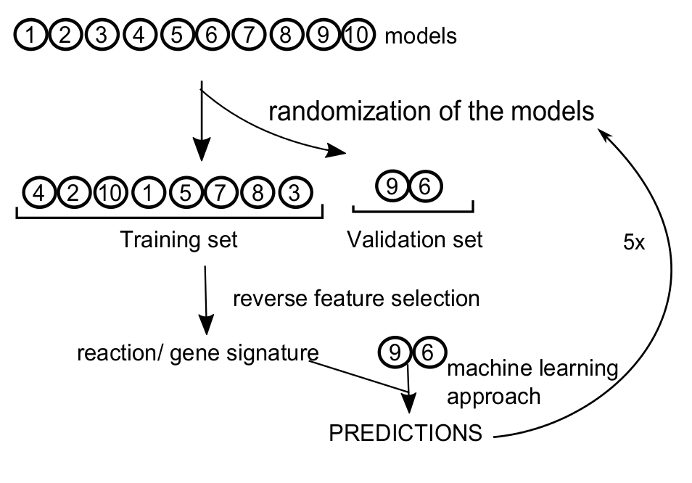
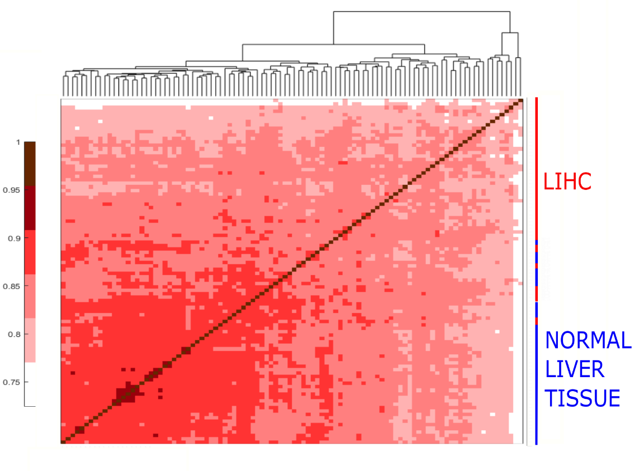
What is the minimum information needed to segregate between healthy and cancer?
ACC 97.7%
True Positives
97.3 %
False
Negatives
2.4%
LIHC
True Class
False Positives
4%
True Negatives
96%
Feature engineering
Healthy
LIHC
Healthy
Predicted class
FASTCORMICS RNAseq: Pires Pacheco et al, submitted

Slide 67
In silico gene knockouts
x
AND
x
AND
x
x
ub and lb set to 0
B
D
biomass
no biomass
v2
v2
B
D
2A
2A
v1
Ex3
v3
C
D
v1
Ex3
v4
v3
C
D
v4

Slide 68
In silico gene knockouts
Healthy cell pathway
Cancer cell pathway
alternative pathways
No flux
M
Biomass
Biomass
M
M
M
M
M
M
Gene deletion
Deletion of this gene
is essential in cancer
M
Metabolite
Reaction flux (regulated by genes)
Notes:
Set an objective function for the model i.e. biomass for growth rate
Remove each gene from the model an assess the flux through the objective function
A gene is essential if it reduces the flux through the objective function

Slide 69




Gene essentiality analysis and datamining to find potential drug targets
DRUG Databases
in silico gene essentiality analysis
Selection of potential non-cancer drugs

Slide 70
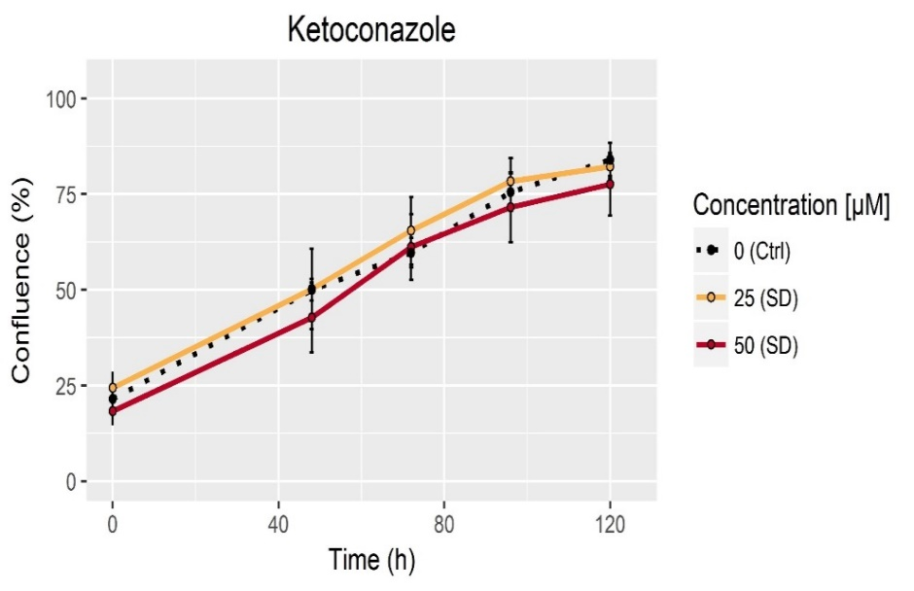
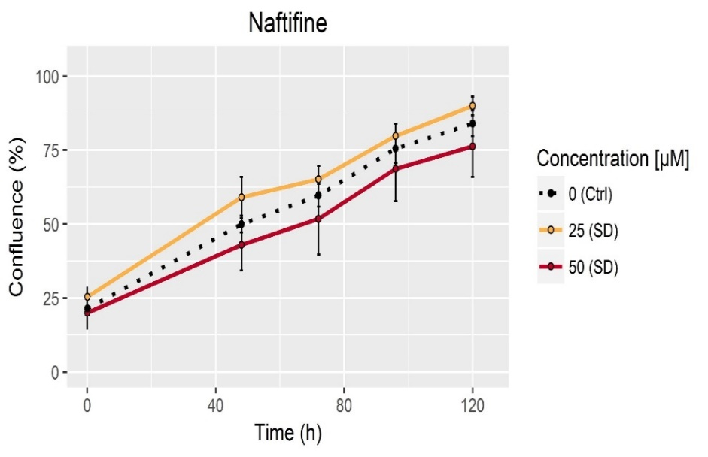
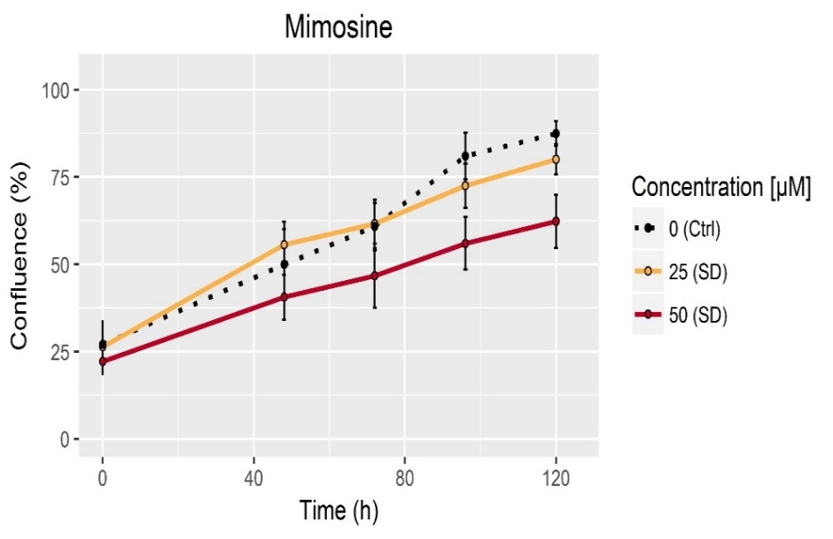
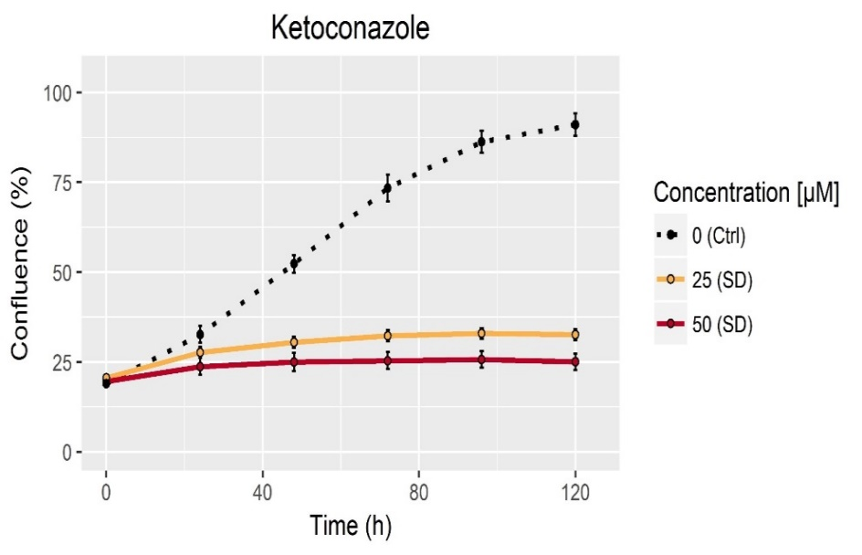
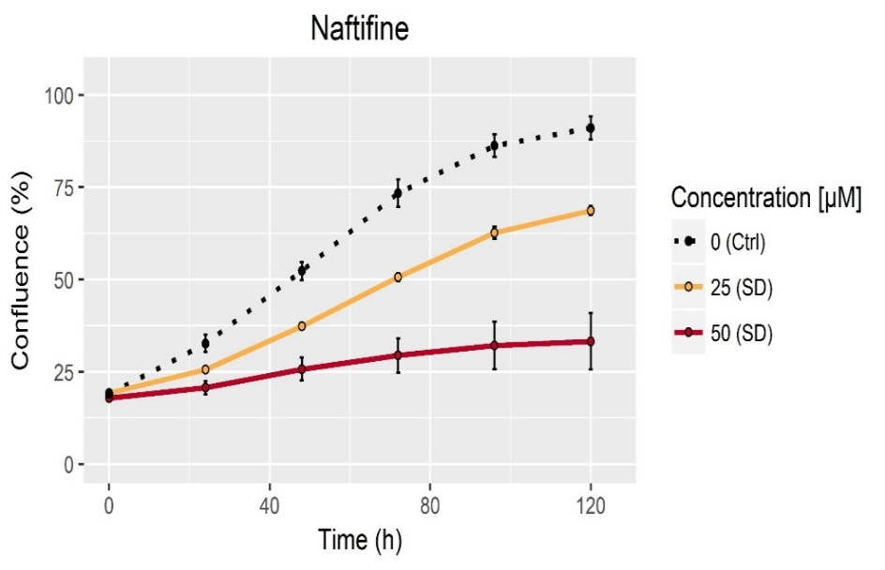
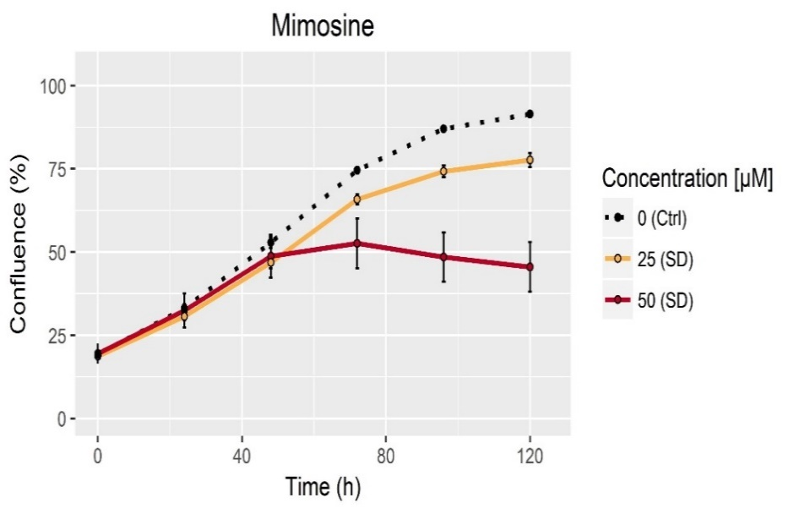
Experimental in vitro validation of the candidate drugs
FASTCORMICS RNAseq: Pires Pacheco et al, in preparation

Slide 71
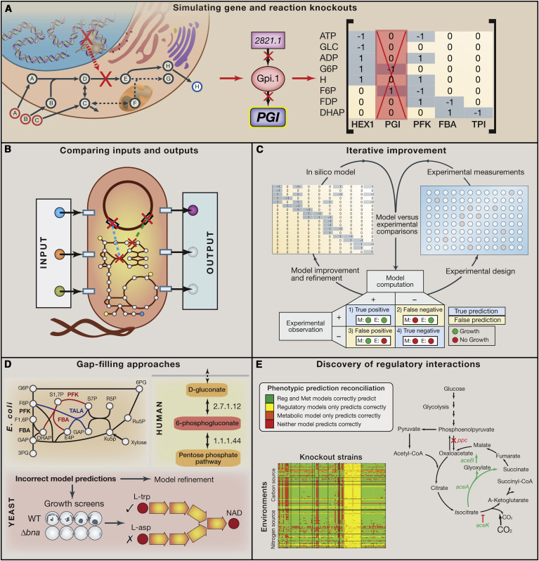
Knock-outs in bacterial/yeast strain design

